Slide 1
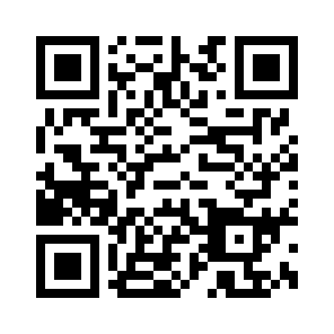
Workshop: EY – ESG meets Audit
Thu, Nov 16th @ 3.00 p.m. – 6.30 p.m.
Do you want to understand the impact of ESG regulation on companies and the role of auditing in this crucial transformation?
Then this ESG meets Audit Workshop with EY is just right for you!
Meet experts and employees in their offices and get to know their working reality at EY!
*The Workshop will be in German
Please register until Nov 5th online https://karrieredatenbank.wiso.uni-koeln.de

